Slide 1

Project Name: OBSTACLE AVOIDANCE ROBOTIC VEHICLE USING ULTRASONIC SENSOR And ARDUINO Course Name: Microprocessor and Embedded System Faculty Name: Md. Ali Noor Section: A Group : 06

Slide 2


Group Members
Md Sumon (20-42556-1)
Maimona Rahman Farjana (20-42954-1)
Md. Sajidul Haque Shohan(20-42022-1)
Md. Rashedul Islam(20-43301-1)
Syeda aynul karim (19-41829-3)
Medha Chowdhury(20-41930-1)
Syed Aftab Uddin(19-41522-3)

Slide 3
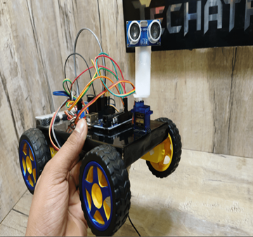
Introduction
Utilizes ultrasonic sensors for guidance and detection
Arduino Uno employed for construction and control
Robotics: rapidly expanding and fascinating field
Autonomous robots perform tasks without human supervision
Obstacle detection is fundamental for autonomous navigation
Sensor-based environment awareness
Obstacle avoidance methods: wall following, edge detection, line following
Edge detection: widely used but may require stopping for accurate measurement

Slide 4
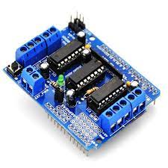
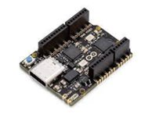
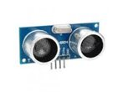
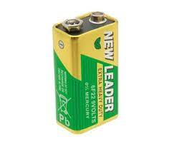
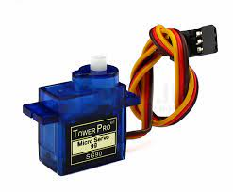
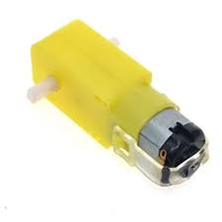
Components
Arduino Uno
Motor Driver Shield
Ultrasonic Sensor
9v battery
Servo Motor
TT Gear Motor(4x)

Slide 5
Working Procedure
When the robot is powered on, all motors of the robot will run normally and the robot moves forward. During this time, the ultrasonic sensor continuously calculate the distance between the robot and the reflective surface.
This information is processed by the Arduino. If the distance between the robot and the obstacle is less than 30cm, the Robot stops and scans in left and right directions for new distance using Servo Motor and Ultrasonic Sensor. If the distance towards the left side is more than that of the right side, the robot will prepare for a left turn. But first, it backs up a little bit and then activates the Left Wheel Motor in reversed in direction.
Similarly, if the right distance is more than that of the left distance, the Robot prepares right rotation. This process continues forever and the robot keeps on moving without hitting any obstacle.

Slide 6
APPLICATIONS
Applied to portable robot navigation systems
Applied to domestic tasks like automatic vacuum cleaning
Used in hazardous conditions where human encroachment might be fatal.
Automatic traffic signal switching
An alarm for intruders
parking meters and access

Slide 7
Flowchart

Slide 8
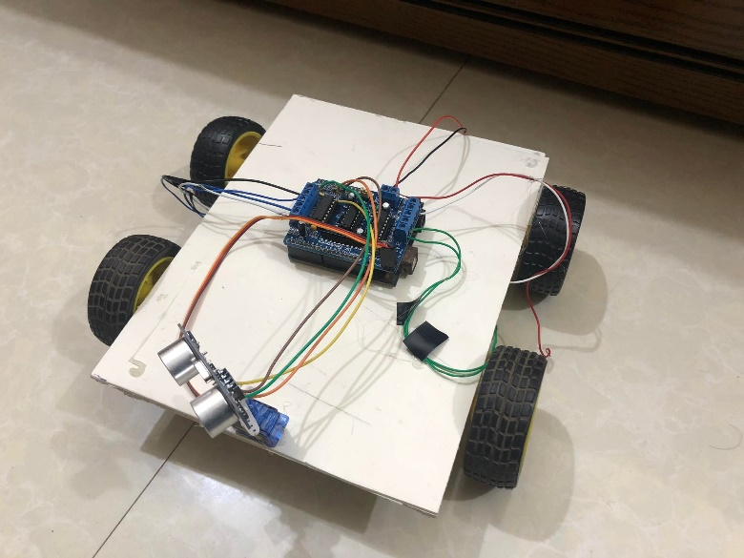
Demonstration
Fig: Result of the project

Slide 9
Conclusion
The obstacle avoidance robotic vehicle effectively combines the functionality of the ultrasonic sensor and Arduino to navigate autonomously and avoid obstacles in its path.
The integration of these technologies provides a cost-effective and efficient solution for small-scale robotics applications and proof of concept demonstrations.
The project demonstrates the potential for using robotics in a variety of fields, including logistics, agriculture, healthcare, and disaster management, to improve efficiency and reduce the reliance on human labor.

Slide 10
Future Improvement
Integrate multiple types of sensors, such as LiDAR, infrared, and cameras, to improve obstacle detection and localization capabilities. Sensor fusion will enable the vehicle to better understand its environment and perform more reliable obstacle avoidance.
Develop more advanced algorithms and machine learning models to optimize path planning, decision-making, and obstacle avoidance, allowing the robotic vehicle to navigate complex environments more efficiently.
Enable the robotic vehicle to communicate with other robots or devices in its environment, allowing for collaborative navigation and task execution. This could be achieved through IoT integration or wireless communication protocols like Wi-Fi or Bluetooth.

Slide 11

THANK YOU

